Slide 1


EDA:BANK LOAN DEFAULT RISK ANALYSIS
MR. SRABANA KUMAR MALLA

Slide 2
CONTENTS
Introduction
Getting Jupyter Ready
Reading & Understanding the data
Data Cleaning & Manipulation
Data Analysis
Merged Dataframes Analysis
Conclusions

Slide 3
INTRODUCTION
This case study aims to give an idea of applying EDA in a real business scenario. In this case study, we will develop a basic understanding of risk analytics in banking and financial services and understand how data is used to minimise the risk of losing money while lending to customers.

Slide 4
RISK ASSOCIATED WITH BANK’S DECISION
If the applicant is likely to repay the loan, then not approving the loan results in a loss of business to the company
If the applicant is not likely to repay the loan, i.e. he/she is likely to default, then approving the loan may lead to a financial loss for the company.

Slide 5
LOAN STATUS
LOAN APPLICATION APPROVED
APPROVED
CANCELLED DURING APPROVEL BY THE CLIENT
CANCELLED
CANCELLED BY THE CLIENT AT DIFFERENT STAGE OF PROCESS
UNUSED
COMPANY REJECT THE LOAN APPLICATION
REFUSED

Slide 6
BUSINESS OBJECTIVE
The company wants to understand the driving factors (or driver variables) behind loan default
Understand the variables which are strong indicators of default.
The company can utilise this knowledge for its portfolio and risk assessment.

Slide 7
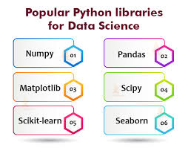

GETTING JUPYTER READY
Importing all the python libraries and setting up the plot style.

Slide 8
READING THE DATA
application_data.csv
previous_application.csv

Slide 9
UNDERSTANDING THE DATA
IMPORTING THE INPUT FILES
INSPECT DATA FRAMES

Slide 10
DATAFRAMES
DATABASE
Application Data Dimension
307511,122
Previous Data Dimension
1670214,37
Application Data Size
37516342
Previous Data Size
61797918

Slide 11
DATA CLEANING & MANIPULATION

Slide 12
ANALYSE & DELETE UNNECESSORY COLUMNS
ANALYSING & DELETING UNNECESSORY COLUMNS IN APPLICATION DATA:
As shown in graphs some columns like EXT_SOURCE_X have no correlation with target and also email, mobile phone this details are not in correlation with loan repayment.
Also when we compare all the FLAG_DOCUMENTS with each other only FLAG_DOCUMENT_3 is required for further analysing having more than 40% null value with that we will also add the columns, so we will remove the unwanted columns from the data set.

Slide 13
ANALYSING & DELETING UNNECESSORY COLUMNS IN PREVIOUS DATA:
We will delete the columns having more than 40% null value, along with that some unnecessary columns like WEEKDAY_APPR_PROCESS_START','HOUR_APPR_PROCESS_START, etc we will remove all the unnecessary columns.
APPLICATION DATA PREVIOUS DATA

Slide 14
STANDARDIZE VALUE
More than 50% loan applicants have income between 100K-200K and among them 92% applicants have income less than 300K.

Slide 15
More than 55% of the loan applicants have work experience within 0-5 years and almost 80% of them have less than 10 years of work experience
31% loan applicants have age above 50 years. More than 55% of loan applicants have age over 40 years.
More Than 16% loan applicants have taken loan which amounts to more than 1M.

Slide 16
NULL VALUE DATA IMPUTATION
Null values in categorical variables which has lower null percentage, we can use mode is used to impute.
To impute null values in categorical variables which has higher null percentage, a new category can be created
To impute null values in numerical variables which has lower null percentage, median is used when there are no outliers in the columns.
We can ignore the variables having less null values.

Slide 17
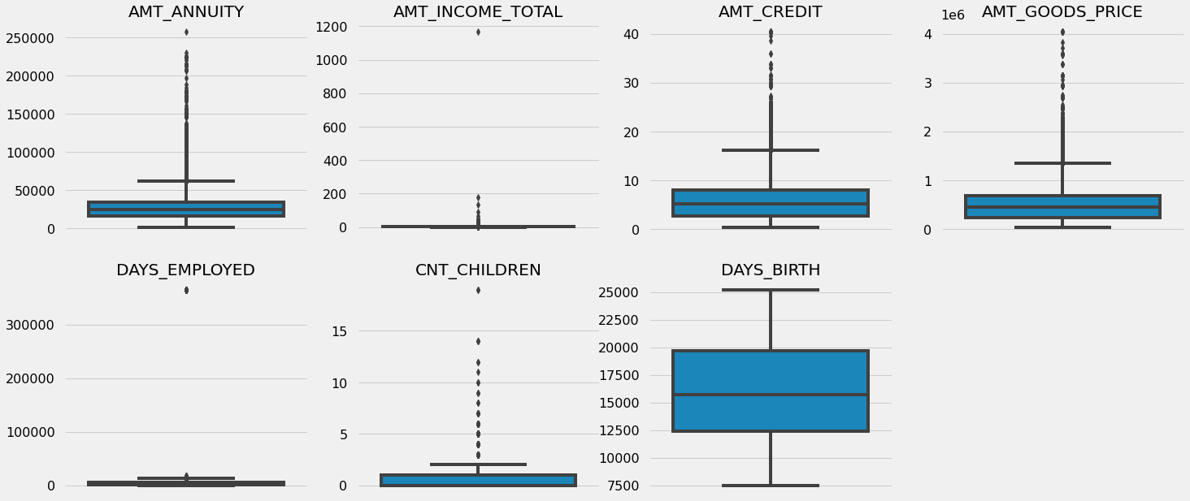
OUTLIERS IDENTIFICATION
APPLICATION DATA
AMT_ANNUITY, AMT_CREDIT, AMT_GOODS_PRICE,CNT_CHILDREN have some number of outliers.
AMT_INCOME_TOTAL has huge number of outliers which indicate that few of the loan applicants have high income when compared to the others.
DAYS_BIRTH has no outliers which means the data available is reliable.
DAYS_EMPLOYED has outlier values around 350000(days) which is around 958 years which is impossible and hence this has to be incorrect entry.

Slide 18
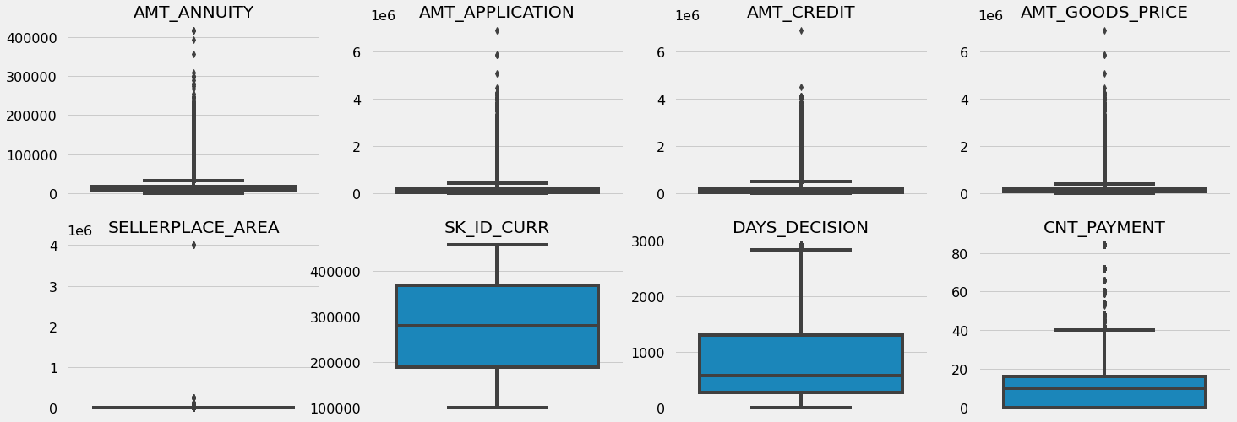
OUTLIERS IDENTIFICATION
PREVIOUS DATA
AMT_ANNUITY, AMT_APPLICATION, AMT_CREDIT, AMT_GOODS_PRICE, SELLERPLACE_AREA have huge number of outliers.
CNT_PAYMENT has few outlier values.
SK_ID_CURR is an ID column and hence no outliers.
DAYS_DECISION has little number of outliers indicating that these previous applications decisions were taken long back.

Slide 19
DATA ANALYSIS
CATEGORICAL DATA ANALYSIS
IMBALANCE IN DATA
NUMERICAL DATA ANALYSIS
DATA ANALYSIS

Slide 20
LOAN REPAYMENT STATUS

Slide 21
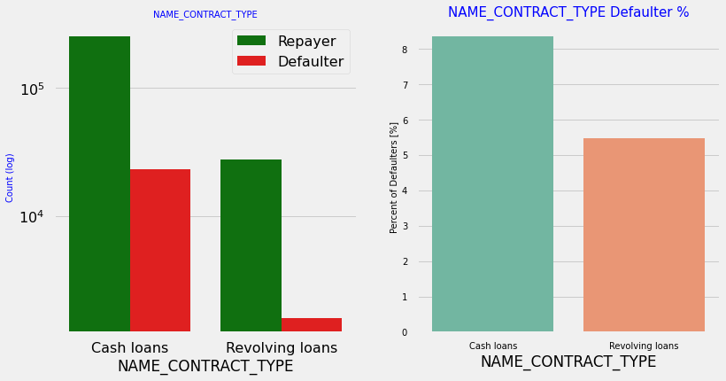
CATEGORICAL DATA ANALYSIS
CONTRACT TYPE
As seen in graphs revolving loans are very less in amount as compared to other loans, but larger amount of revolving loans are not paid.

Slide 22
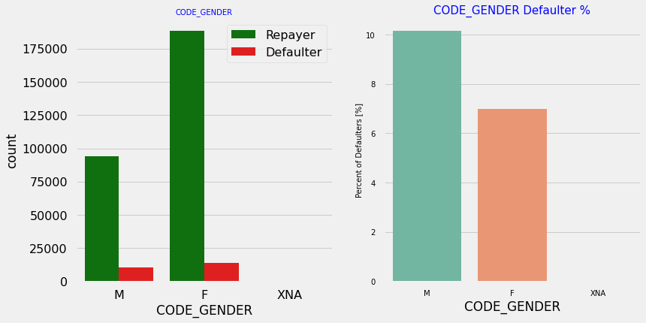
CODE GENDER
As seen in graphs most of the females has taken more loans than males but when we analyze the defaulters, males have a higher chance of not returning a loans.

Slide 23
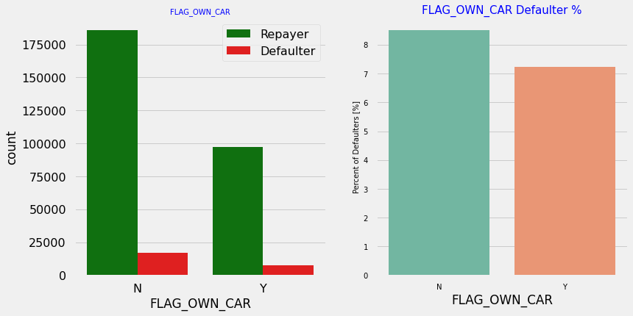
FLAG OWN CAR
There is no major difference in clients owing a car or not. In both cases the default percentage is almost same.

Slide 24
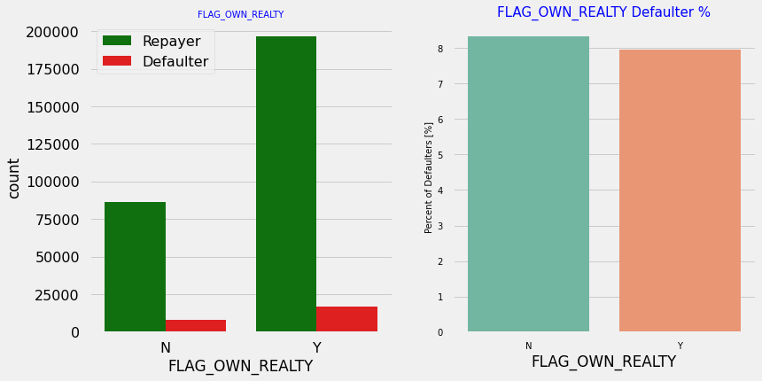
FLAG OWN REALTY
The clients who own real estate are more than double of the ones that don't own. But the defaulting rate of both categories are around the same. Thus there is no correlation between owning a realty and defaulting the loan.

Slide 25
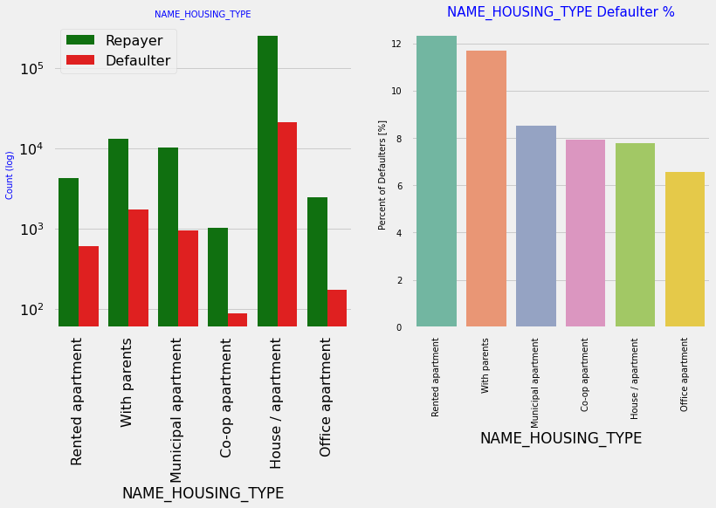
NAME HOUSING TYPE
Most of the people live in Apartments/Houses, People living with parents and in a rented apartments have more probability of being defaulters.

Slide 26
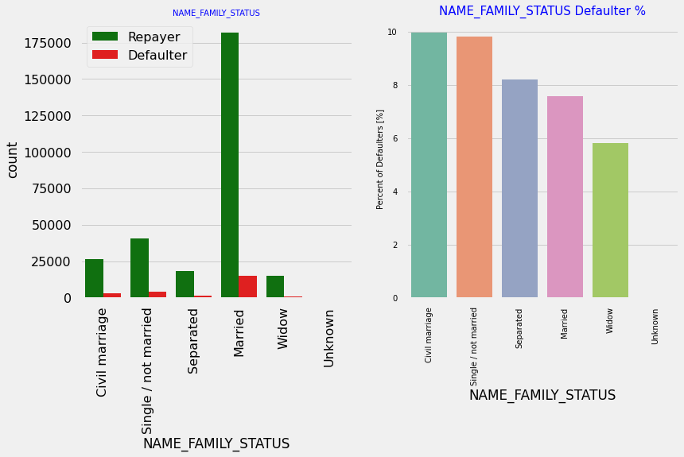
NAME FAMILY STATUS
Most of the married persons has taken loan, In terms of percentage of not repayment of loan, Civil marriage has the highest percent of not repayment, whereas Widow has the lowest percent.

Slide 27
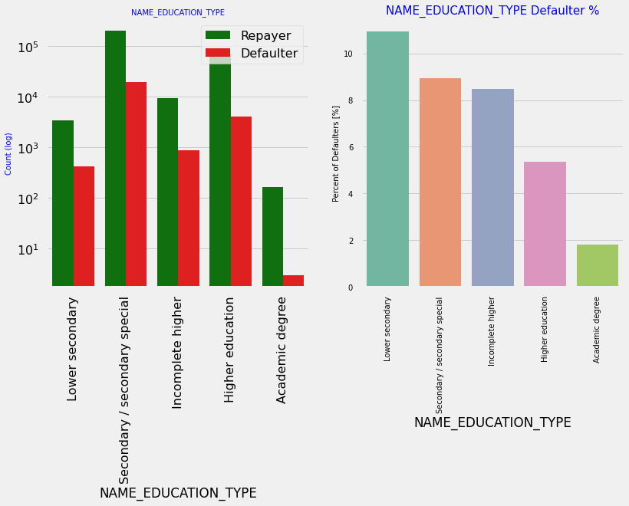
NAME EDUCATION TYPE
Most of the clients who has taken loans have secondary special education, very less clients have higher academic degree. But when we compare defaulters lower secondary has the highest percentage of defaulters as compared to others whereas academic degree have lowest defaulting rate.

Slide 28
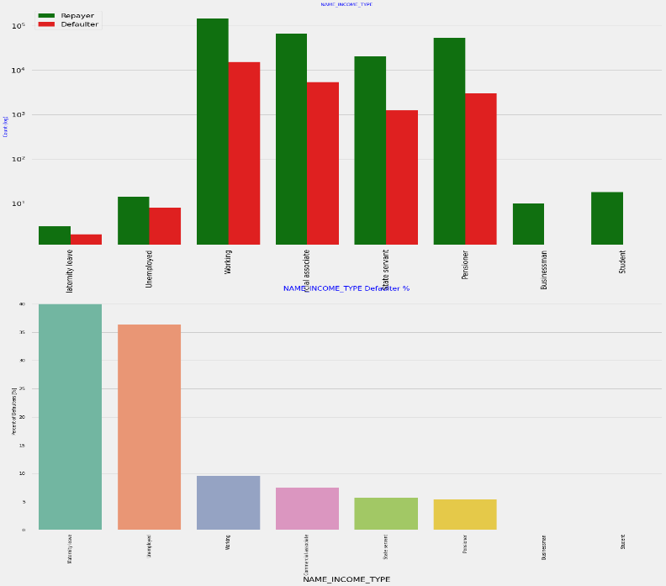
NAME INCOME TYPE
Mostly applicants are working, followed by Commercial associate, Pensioner and State servant. Applicants having income type maternity leave and unemployed applicants have more defaulting rate, whereas businessmen's and students don’t have any default record.

Slide 29
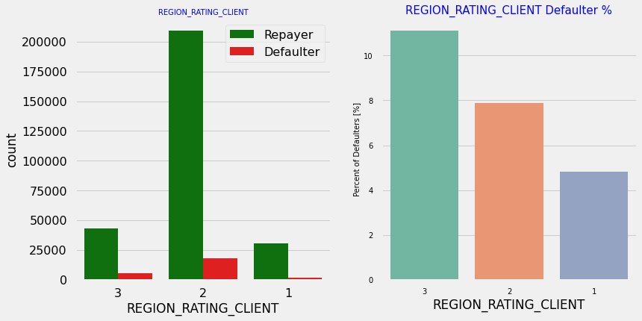
REGION RATING CLIENT
Most of the applicants are living in Region Rating 2 place. Region Rating 3 has the highest default rate. Applicant living in Region Rating 1 has the lowest probability of defaulting.

Slide 30
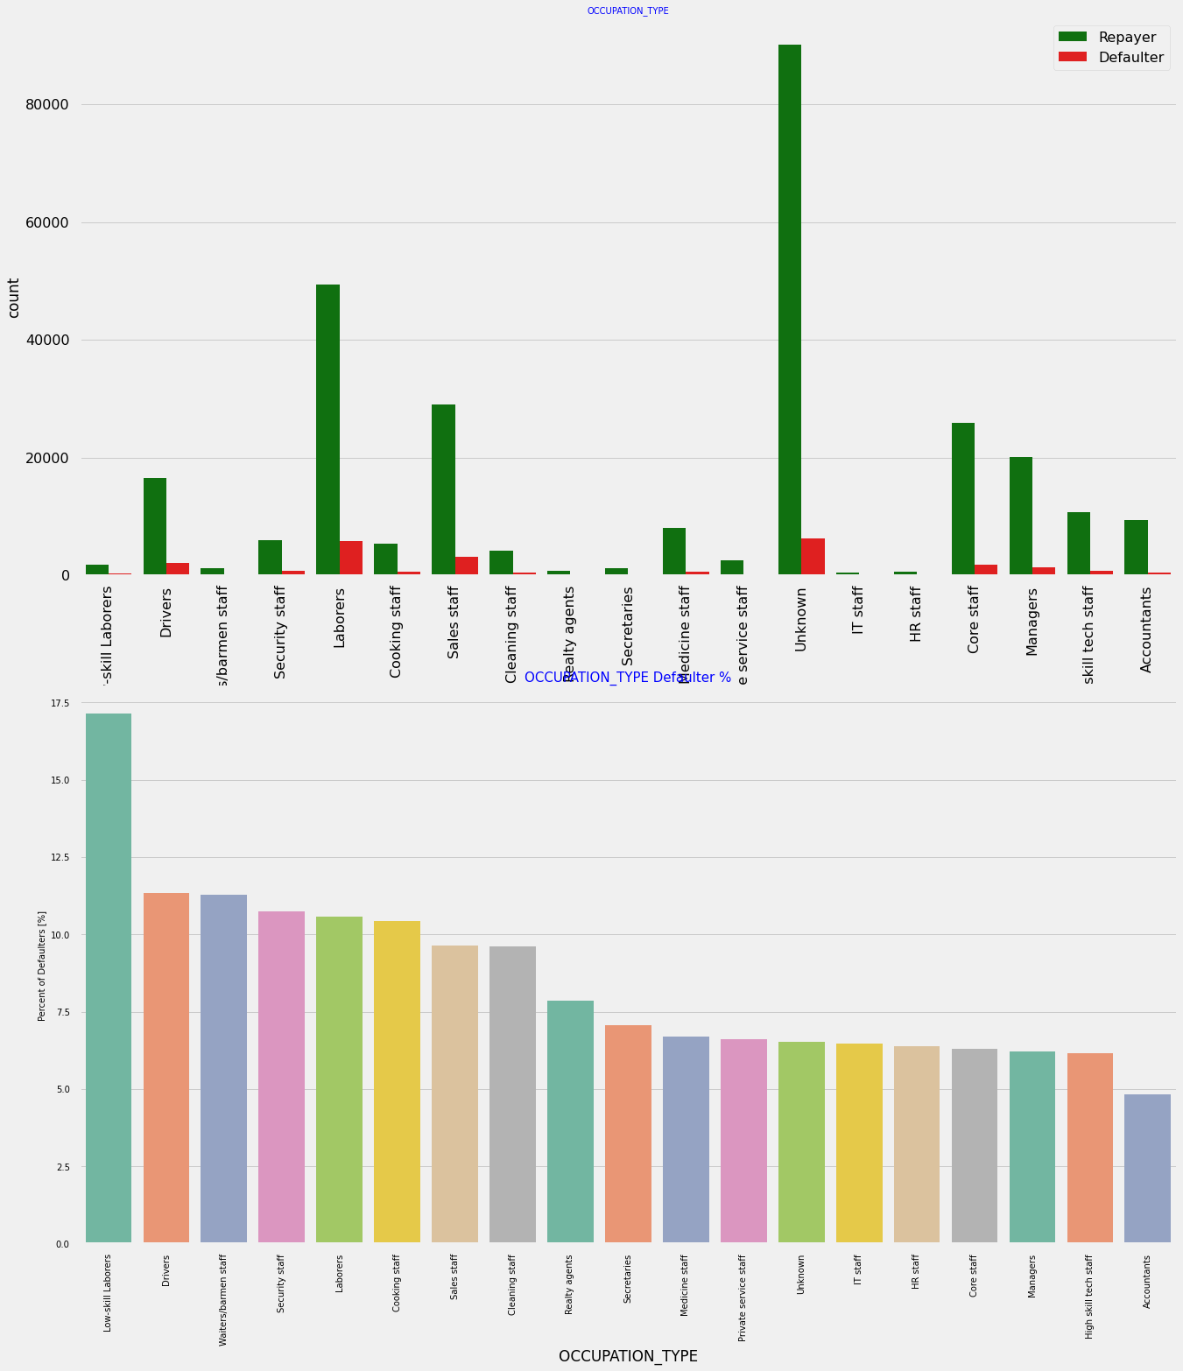
OCCUPATION TYPE
Most of the loans are taken by Laborers, followed by Sales staff. IT staff take the lowest amount of loans. The category with highest percent of not repaid loans are Low-skill Laborers (above 17%), followed by Drivers and Waiters/barmen staff, Security staff, Laborers and Cooking staff.

Slide 31
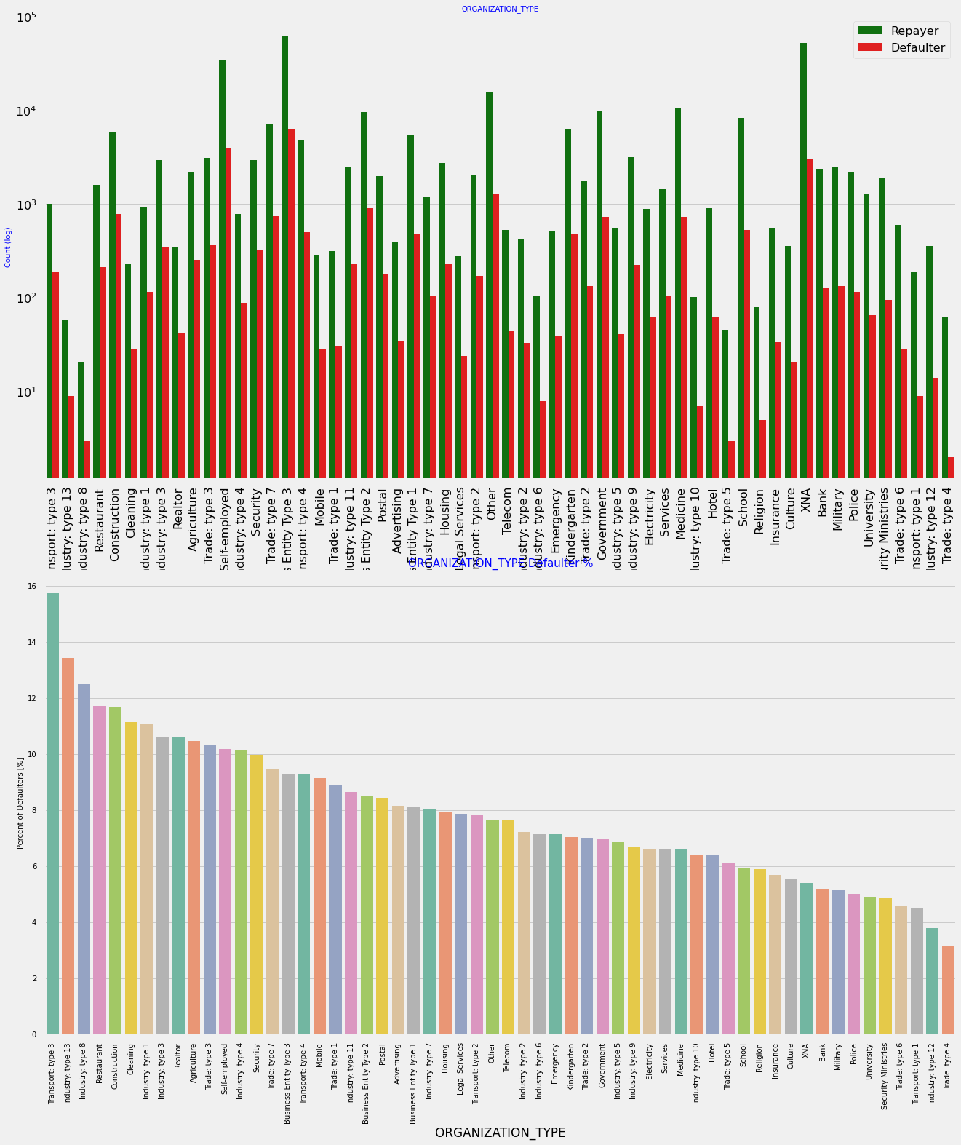
ORGANIZATION TYPE
Organizations with highest percent of loans not repaid are Transport: type 3, Industry: type 13, Industry: type 8 and Restaurant . Self employed people have relative high defaulting rate, and thus should be avoided to be approved for loan or provide loan with higher interest rate to mitigate the risk of defaulting.
Most of the people application for loan are from Business Entity Type 3. For a very high number of applications, Organization type information is unavailable(XNA), It can be seen that following category of organization type has lesser defaulters thus safer for providing loans: Trade Type 4 and 5, Industry type 8

Slide 32
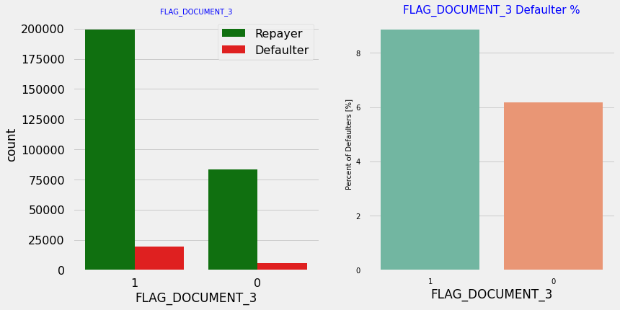
FLAG DOCUMENT 3
As we can se that there is no correlation between repayor's and defaulter’s with submitting Flag document 3, as we see applicants have submitted the document, they have defaulted a slightly more than who have not submitted the document.

Slide 33
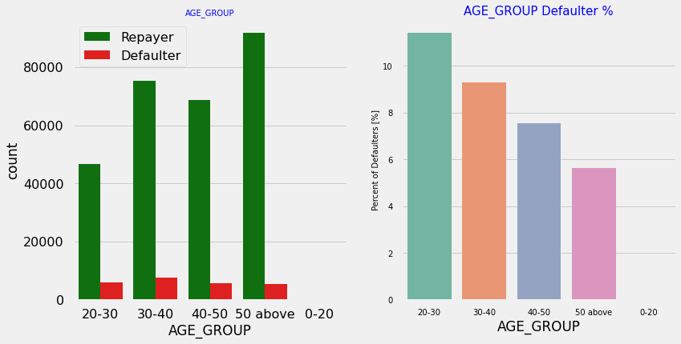
AGE GROUP
People in the age group range 20-40 have higher probability of defaulting, People above age of 50 have low probability of defaulting.

Slide 34
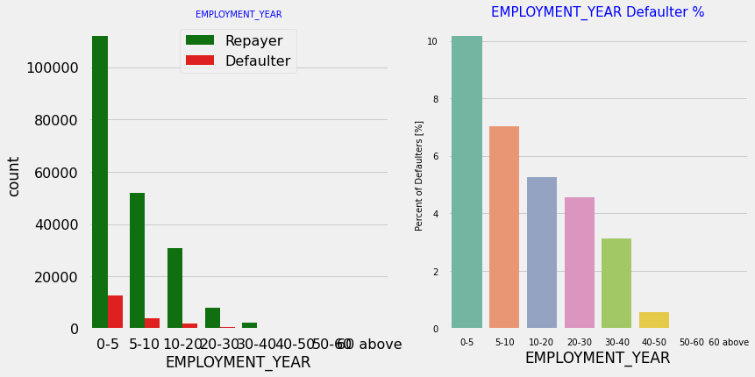
EMPLOYMENT YEAR
Majority of the applicants have been employeed in between 0-5 years. The defaulting rating of this group is also the highest which is
With increase of employment year, defaulting rate is gradually decreasing with people having 40+ year experience having less default rate.

Slide 35
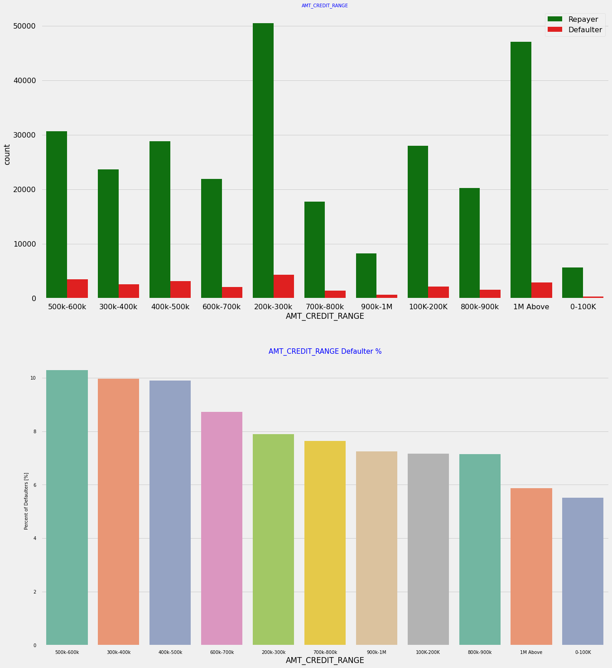
AMOUNT CREDIT RANGE
More than 80% of the loan provided are for amount less than 900,000, People who get loan for 300-600k tend to default more than others.

Slide 36
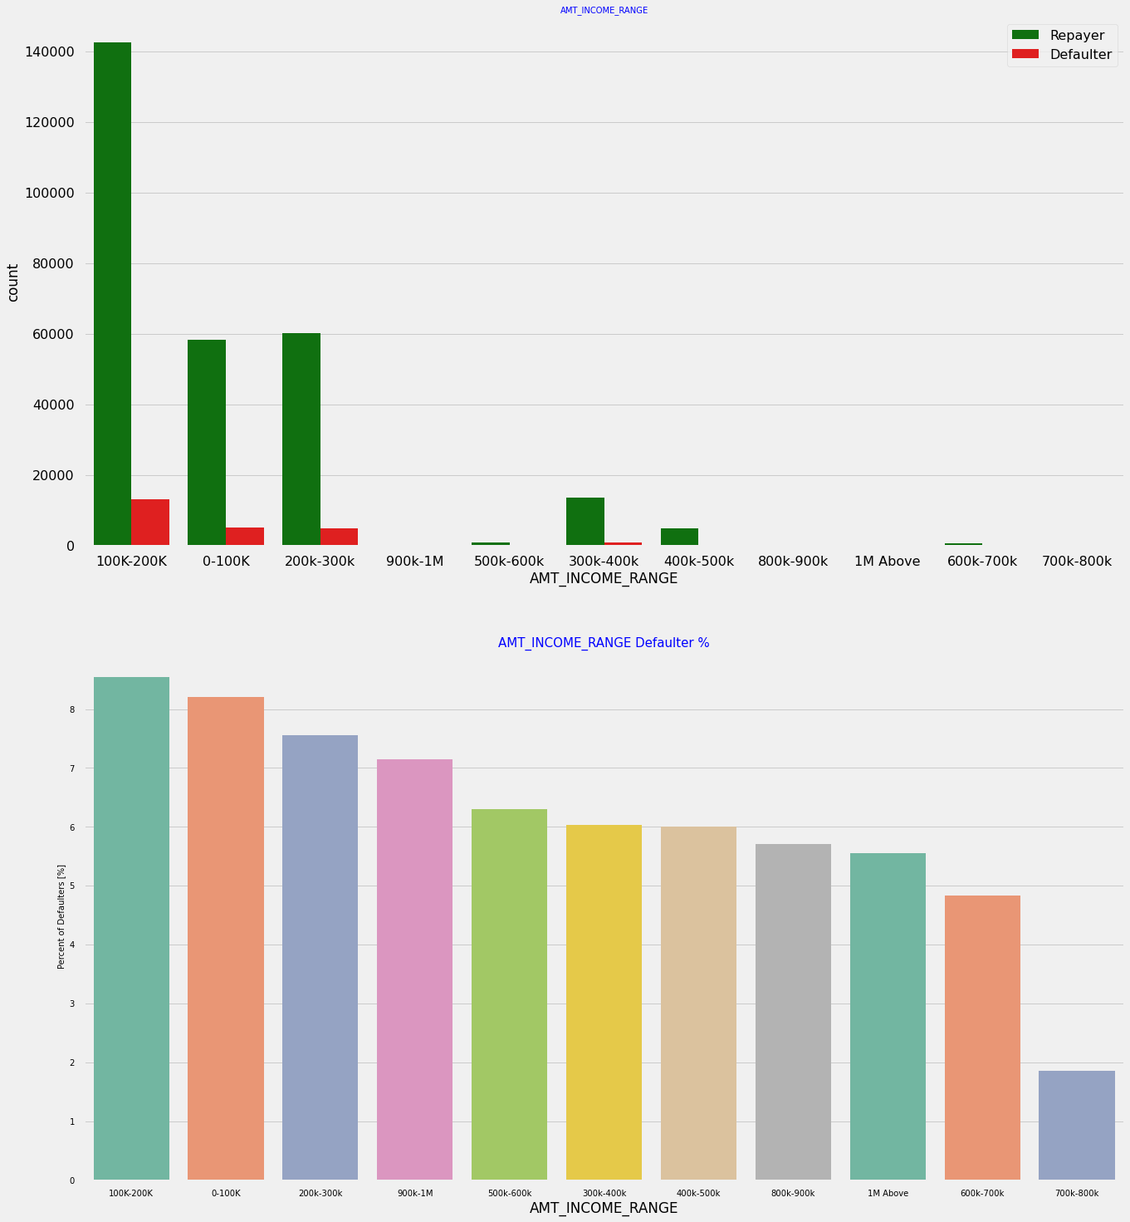
AMOUNT INCOME RANGE
Most of the applications have Income total less than 300,000. Application with Income less than 300,000 has high probability of defaulting, Applicant with Income more than 700,000 are less likely to default.

Slide 37
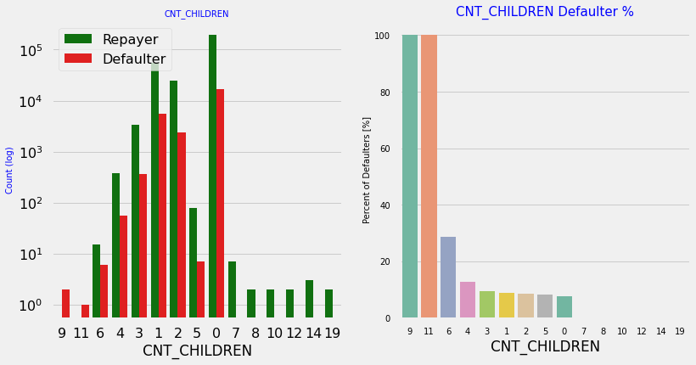
COUNT CHILDREN
Most of the applicants do not have children. Very few clients have more than 3 children. Client who have more than 4 children has a very high default rate.

Slide 38
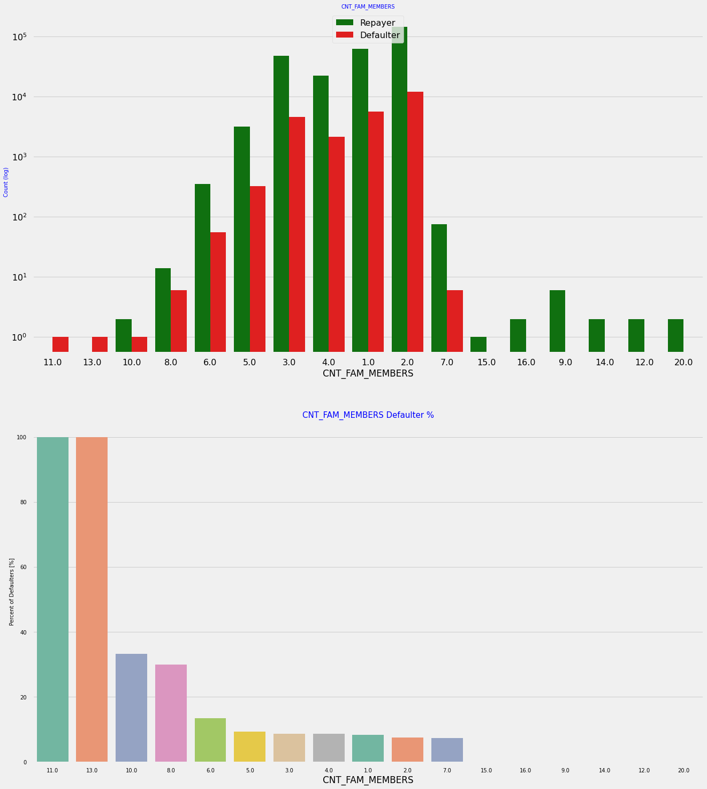
COUNT FAMILY MEMBERS
Family member follows the same trend as children where having more family members increases the risk of defaulting.

Slide 39
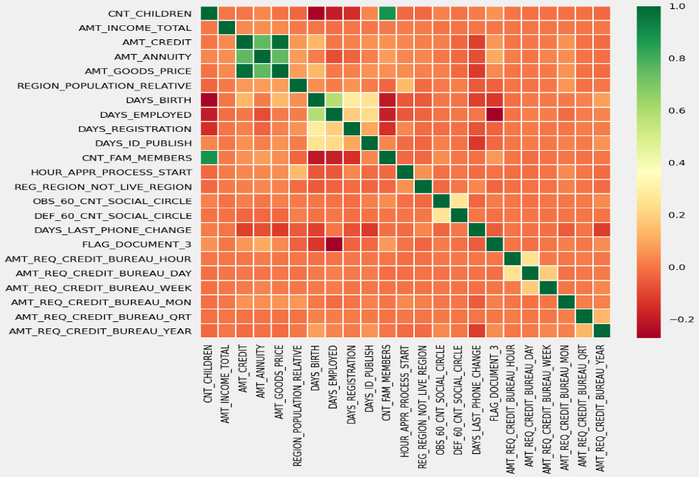
NUMERICAL DATA ANALYSIS
CORRELATION WITH REPAYER DATA
As we can see that there is no correlation between all the variables with repaying credit amount. But Credit amount is highly correlated with amount of goods price, loan annuity, total income

Slide 40
CORRELATION WITH DEFAULTER DATA
Credit amount is highly correlated with amount of goods price which is same as repayers.
But the loan annuity correlation with credit amount has slightly reduced in defaulters(0.75) when compared to repayors(0.77)
We can also see that repayors have high correlation in number of days employed(0.62) when compared to defaulters(0.58).
There is a severe drop in the correlation between total income of the client and the credit amount(0.038) amongst defaulters whereas it is 0.342 among repayers.
Days birth and number of children correlation has reduced to 0.259 in defaulters when compared to 0.337 in repayors.
There is a slight increase in defaulted to observed count in social circle among defaulters(0.264) when compared to repayors(0.254)

Slide 41
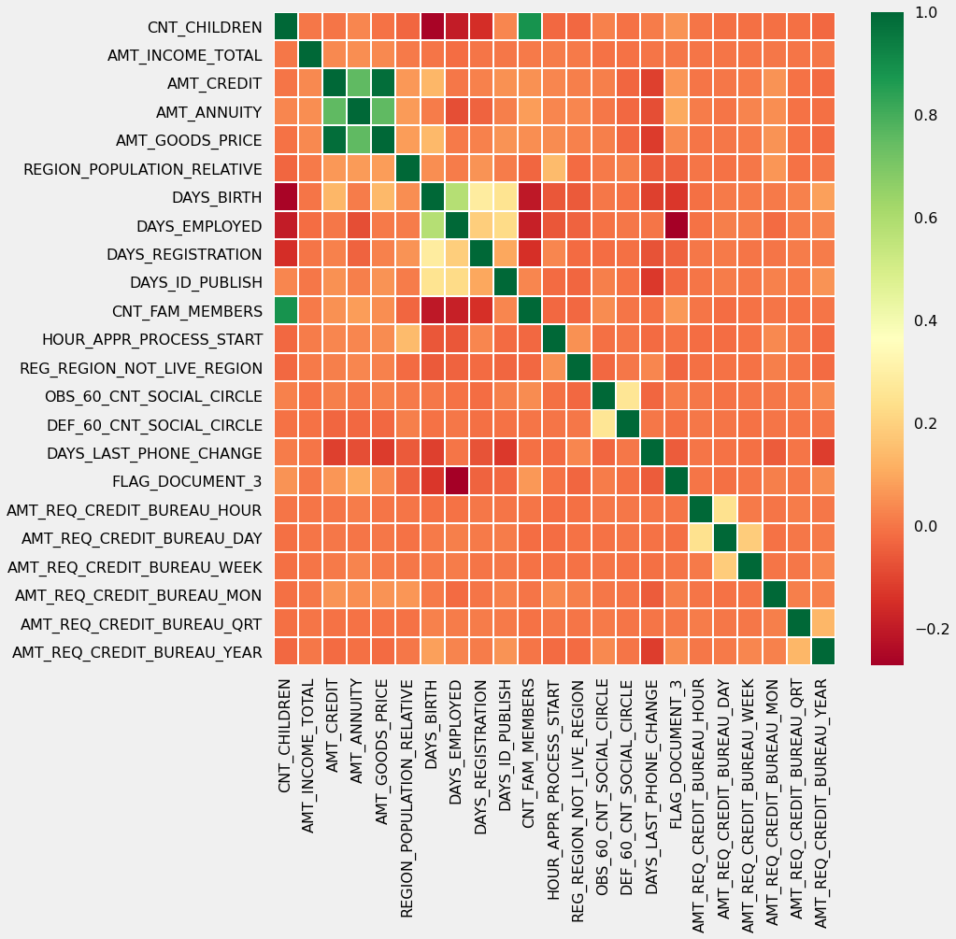

Slide 42
As shown in graphs:
Most no of loans are given for goods price below 10 lakhs
Most people pay annuity below 50000 for the credit loan
Credit amount of the loan is mostly less then 10 lakhs
The repayors and defaulters distribution overlap in all the plots and hence we cannot use any of these variables in isolation to make a decision.
When the credit amount goes beyond 3M, there is an increase in defaulters.

Slide 43
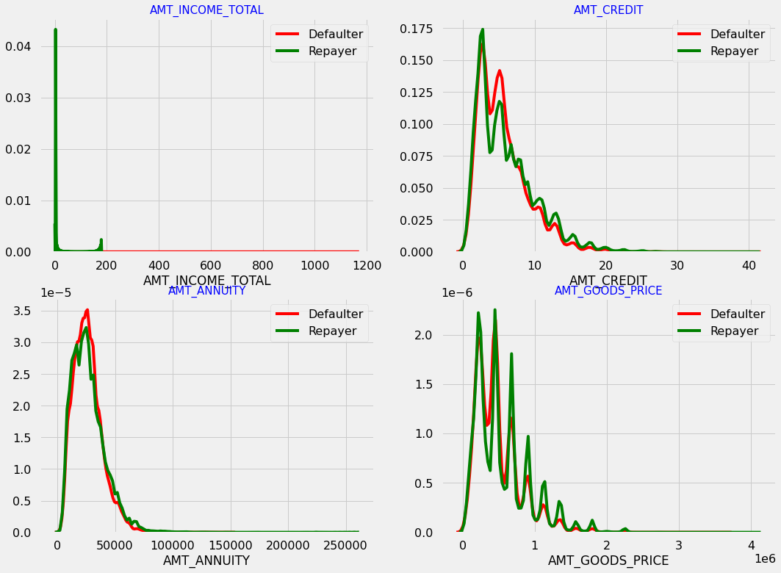
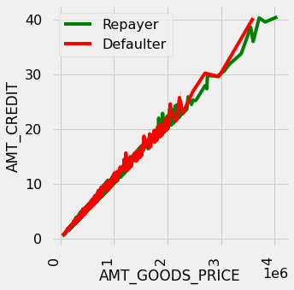

Slide 44
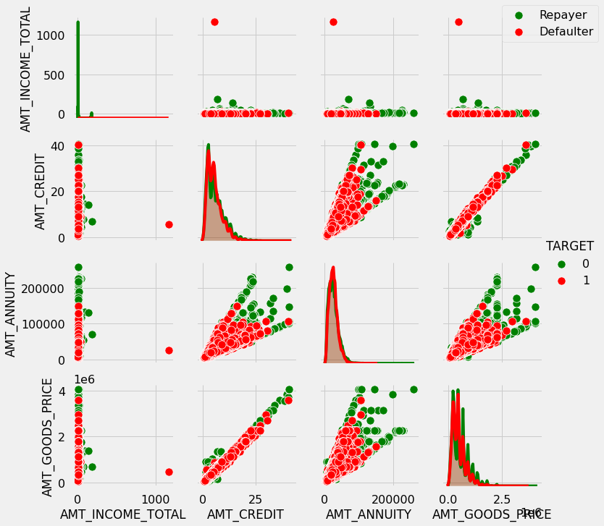
AMT_CREDIT and AMT_GOODS_PRICE are highly correlated as based on the scatterplot where most of the data are consolidated in form of a line
AMT_GOODS_PRICE is correlated with AMT_ANNUITY.

Slide 45
CONTRACT STATUS
When we analyse the contract status with purpose of loan:
The Loan purpose has high number of unknown values (XAP, XNA).
Loan taken for the purpose of Repairs seems to have highest default rate.
A very high number application have been rejected by bank or refused by client which has purpose as repair or other. This shows that purpose repair is taken as high risk by bank and either they are rejected or bank offers very high loan interest rate which is not feasible by the clients, thus they refuse the loan.

Slide 47
CONTRACT STATUS
90% of the previously cancelled client have actually repaid the loan. Revisiting the interest rates would increase business opportunity for these clients
88% of the clients who have been previously refused a loan has paid back the loan in current case.
Refusal reason should be recorded for further analysis as these clients would turn into potential repaying customer.

Slide 48
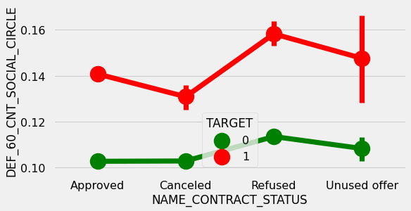
Clients who have average of 0.12 or higher DEF_60_CNT_SOCIAL_CIRCLE score tend to default more and hence client's social circle has to be analyzed before providing the loan.

Slide 49
CONCLUSION
DECISIVE FACTOR WHETHER AN APPLICANT WILL BE REPAYER:
Cash loans has less defaulting rate,
Number of female clients are more than males and also the defaulting rates are less than the Males.
Clients living in office apartments has lowest defaulting rate.
Persons having high academic degree are less defaulters
Students and businessmen’s are less defaulters
Clients with industry type 8 & trade type 4 and 5 have less defaulting rate.
People above age of 50 have low probability of defaulting
Clients having experience more than 4o+yrs are having less defaulting rate
Persons having income more than 7lakh are less defaulters.
Loans bought for Hobby, Buying garage are being repaid mostly.
People with zero to two children tend to repay the loans.

Slide 50
DECISIVE FACTOR WHETHER AN APPLICANT WILL BE DEFAULTER:
Revolving loans are mostly not paid
Men are at relatively higher default rate.
People living with parents are likely to be more defaulters
People who have civil marriage or who are single default a lot.
People with Lower Secondary & Secondary education
Clients who are either at Maternity leave OR Unemployed default a lot.
Low skill workers, labors, cooking staff, security, drivers have more defaulting rate.
Organizations with highest percent of loans not repaid are Transport: type 3, Industry: type 13, Industry: type 8 and Restaurant . Self-employed people have relative high defaulting rate, and thus should be avoided to be approved for loan or provide loan with higher interest rate.
People who are in age group of 20-40 as they have higher probability of defaulting.
People who have less than 5 years of employment have high default rate.

Slide 51
Client who have children equal to or more than 9 default 100% and hence their applications are to be rejected.
Clients having income less than 3lakhs are likely to be more defaulters.
More family members in a family also increases the default rates.
Clients who doesn’t pay the 60days have chances of being defaulter
When the credit amount increases by 3million there is a chance of increase in default rate.

Slide 52
Suggestions
Bank should do proper background verification on several aspects like:
House type
Income
Family background
Financial capability
Purpose of loan
Past credit records
Amount of credit needed to client
Tennure
Other KYC verifications

Slide 53
90% of the previously cancelled client have actually repayed the loan. Record the reason for cancellation which might help the bank to determine and negotiate terms with these repaying customers in future for increase business opportunity.
88% of the clients who were refused by bank for loan earlier have now turned into a repaying client. Hence documenting the reason for rejection could mitigate the business loss and these clients could be contacted for further loans.

Slide 54
THANK YOU

